Slide 1
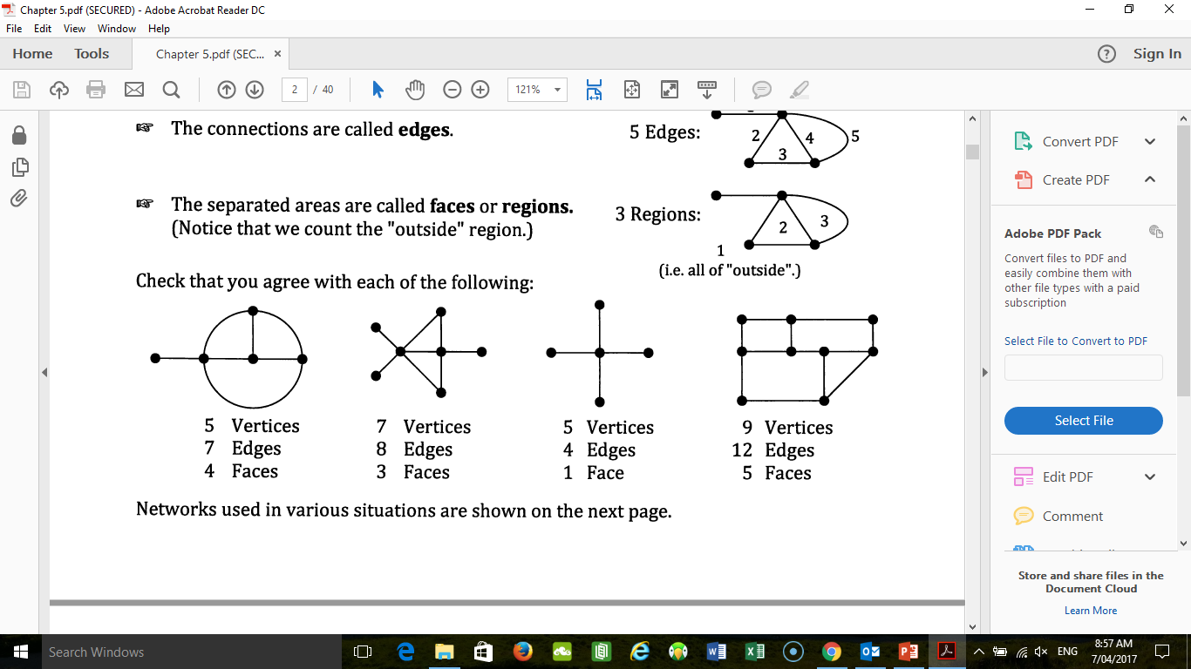
NETWORKS
1

Slide 2
24
7
30
Date
Networks
EQ – What does a network contain?
5

Slide 3

24
7
30
Date
Networks
EQ – What does a network contain?
Vertices (sing: vertex) or nodes
Junctions and end points
5

Slide 4

24
7
30
Date
Networks
EQ – What does a network contain?
Vertices (sing: vertex) or nodes
Edges
Junctions and end points
Connections
5

Slide 5

24
7
30
Date
Networks
EQ – What does a network contain?
Vertices (sing: vertex) or nodes
Edges
Faces or Regions
Junctions and end points
Connections
Separated areas:
5

Slide 6
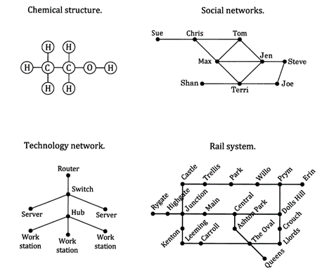
24
7
30
Date
Networks
EQ – What does a network contain?
Examples in life?
5

Slide 7

Questions
Complete the questions from 5A on pages 113 to 115.

Slide 8
24
7
30
Date
Networks
EQ – How do you know if a network is traversable or not?
What is Euler’s rule?
*pronounced oiler
What does Traversable mean?
Traversable or not?
F + V = E + 2
*for any polyhedron that does not intersect itself
F – Faces
V – Vertices (corners)
E – Edges
Any network that can be drawn without taking the pen off the paper or going over the same edge twice.
Count the number of nodes (vertices) with an ODD number of edges joining to it.
NO odd nodes or TWO odd nodes = traversable
No odd nodes = traversable path
Two odd nodes = traversable circuit
5

Slide 9
24
7
30
Date
Networks
5B Vocabulary
Graph Theory
What is a graph?
What is a loop?
What are multiple edges?
What is a weighted graph/network?
What are directed edges/arcs?
What is a simple graph / simple network?
The study of networks
A diagram with vertices and edges.
An edge that starts and finishes at the same vertex.
Two or more edges that connect the same two vertices.
Edges that are ‘worth’ different amounts (distance, cost, time etc).
Edges with directions given
Graphs without directed edges are call undirected graphs, graphs with directed edges are call directed graphs.
An undirected, unweighted graph with no loops or multiple edges.
5

Slide 10
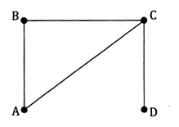
24
7
30
Date
Networks
5B Vocabulary
What is a walk?
Closed walk
Open walk
Length
Connected vertices
Adjacent vertices.
Any path on a network from one vertex to another
e.g.
A walk that starts and finishes at the same vertex e.g. ABCA
A walk that ends at a different vertex e.g. ABCD
*a walk can repeat edges e.g. ACBCD
The number of edges used in the walk.
If it is possible to get from one vertex to another along several edges.
If the vertices are connected by only one edge.
ACD and ABCD are ‘walks’ from A to D
5

Slide 11
24
7
30
Date
Networks
5B Vocabulary
What is a walk?
Trail
Path
Cycle
Connected graph
Bridge
Complete Graphs (Kn)
Any path on a network from one vertex to another
e.g.
A walk that involves no repeated edges eg CABCD
A walk that involves no repeated edges or vertices (other than perhaps the start/finish) Eg ABCD
Closed Path Eg ABCA
All vertices are connected vertices
An edge that when removed leaves the graph disconnected
Simple graphs where all vertices are joined by exactly 1 edge
ACD and ABCD are ‘walks’ from A to D
5

Slide 12
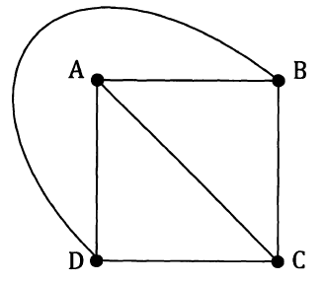
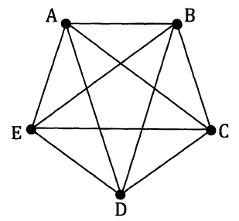
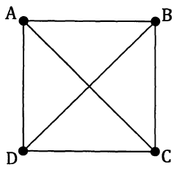
24
7
30
Date
Networks
5C Vocabulary
Planar Graphs
A graph that can be drawn in the same plane (without its edges crossing over).
Could be drawn like this!
Not Planar
Planar!
12 + 5 ≠ 20 + 2
5 + 4 ≠ 8 + 2
4 + 4 = 6 + 2
Euler’s Rule
Euler’s Rule ( f + v = e + 2) can be used to prove if a shape has been drawn planar.
5

Slide 13
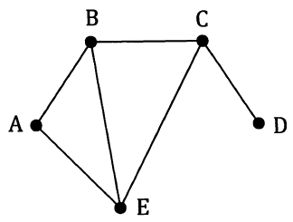
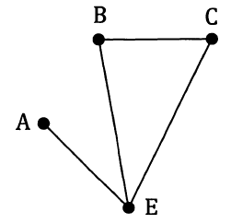
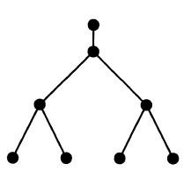
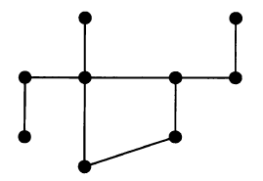
24
7
30
Date
Networks
5C Vocabulary
Subgraphs
Part of an original graph
Original
Subgraph
Bipartite Graphs
A graph where vertices are split into 2 groups and no edges join vertices of the same group.
Trees
A connected simple graph (no loops, no multiple edges) that contains no cycles (closed paths). Every edge must be a bridge.
Note: A tree with n vertices has n-1 edges
Tree
Not a Tree (contains a cycle)
5

Slide 14
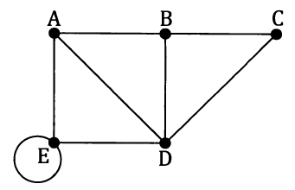
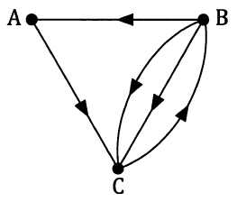
24
7
30
Date
Networks
5D Vocabulary
Degree or order of a vertex
In an undirected network we say that the degree or order of a vertex is the number of edges meeting at that vertex.
If the degree of a vertex is an odd number, we say call that vertex an odd vertex. Same thing applies to even.
Odd Vertices: A & B
Even Vertices: C, D & E*
In-degree and out-degree of a vertex
In a directed network, we have in-degrees (amount of edges coming in to a vertex) and out-degrees (amount going out).
Vertex B: In-degree of 1
Out-degree of 3
5

Slide 15
24
7
30
Date
Networks
Reminder about being traversable
What does Traversable mean?
Traversable or not?
Any network that can be drawn without taking the pen off the paper or going over the same edge twice.
Count the number of nodes (vertices) with an ODD number of edges joining to it.
NO odd nodes or TWO odd nodes = traversable
No odd nodes = traversable path
Two odd nodes = traversable circuit
5

Slide 16
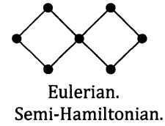
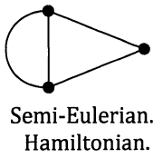
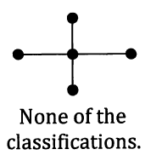
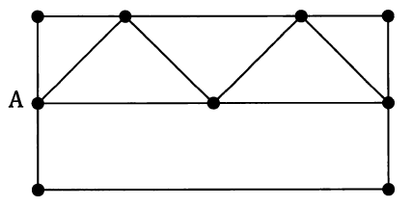
24
7
30
Date
Networks
5D Vocabulary
Eulerian Trail
A trail in a connected graph that covers all edges once (only), therefore traversable. Repeated vertices is okay
Closed: Eulerian circuit (will have no odd vertices)
Open: Semi-Eulerian (will have two odd vertices)
Hamiltonian Path
A path in a graph that visits every vertex once (only).
Missing edges is okay but you can’t repeat an edge
Starting and finishing at the same vertex is okay
Closed: Hamiltonian cycle
Open: Semi-Hamiltonian
What you need to remember!
Eulerian: Edges Hamiltonian: Vertices
5

